Slide 1
V International Workshop on Professional Retraining and Life-Long Learning using ICT: Person-oriented Approach (3L-Person)
5th International Workshop Professional Retraining and Life-Long Learning using ICT: Person-Oriented Approach
3L-Person
Oleksandr BUROV
Institute of Information Technologies and Educational Tools
National Academy of Pedagogic Science
Kiev, Ukraine

Slide 2
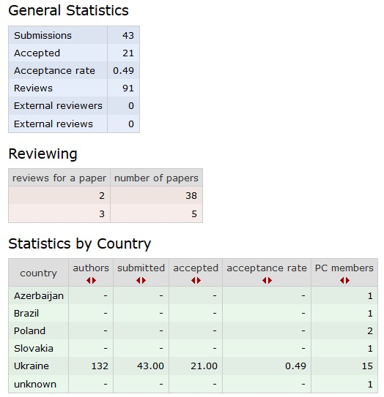
5th International Workshop Professional Retraining and Life-Long Learning using ICT: Person-Oriented Approach
3L-Person

Slide 3
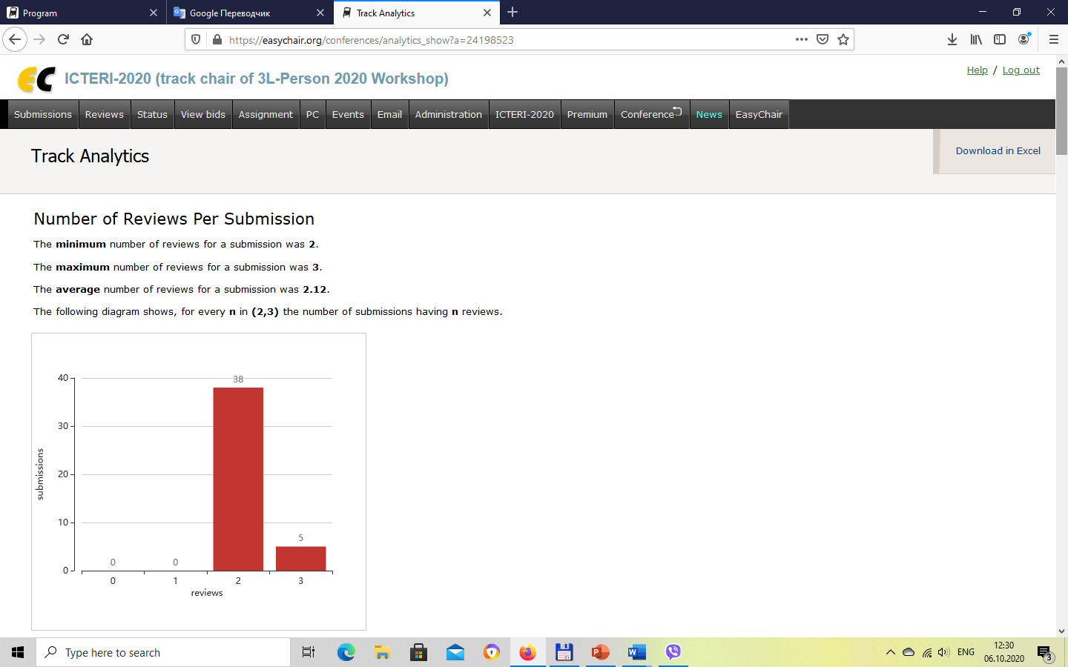
5th International Workshop Professional Retraining and Life-Long Learning using ICT: Person-Oriented Approach
3L-Person

Slide 4
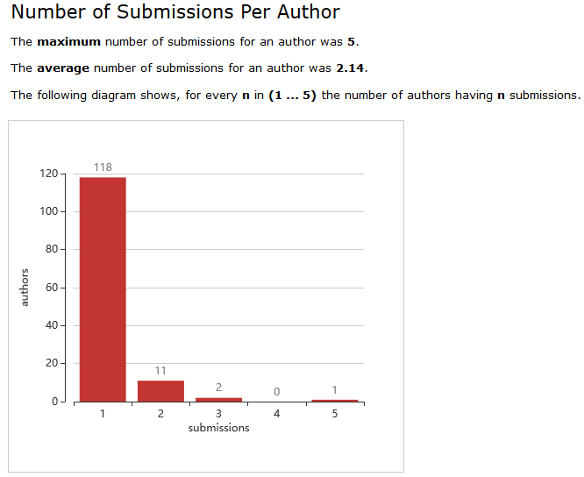
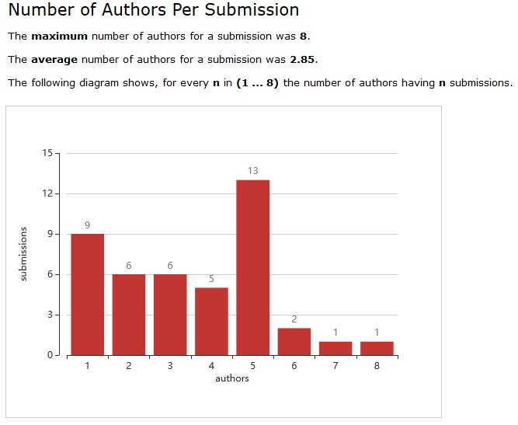
5th International Workshop Professional Retraining and Life-Long Learning using ICT: Person-Oriented Approach
3L-Person

Slide 5
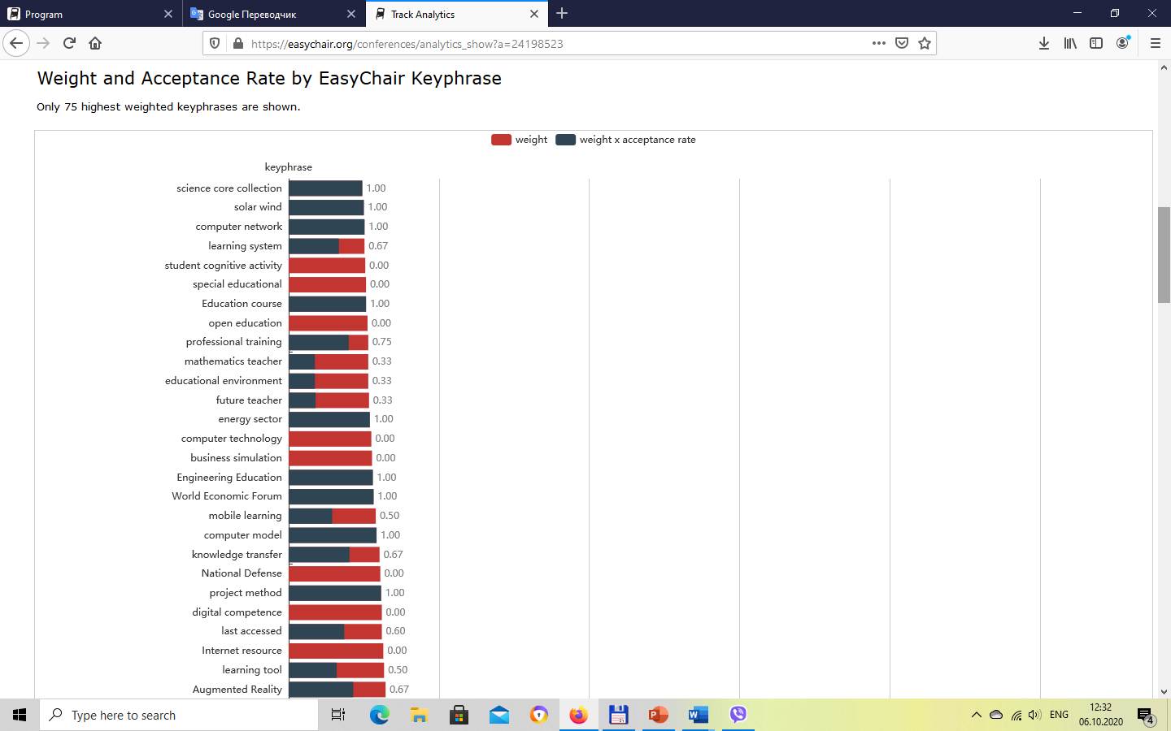
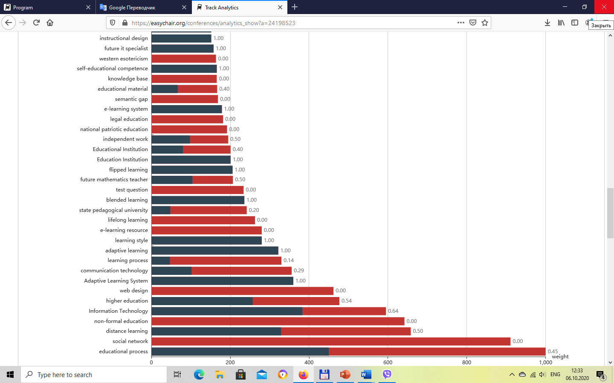
5th International Workshop Professional Retraining and Life-Long Learning using ICT: Person-Oriented Approach
3L-Person

Slide 6
5th International Workshop Professional Retraining and Life-Long Learning using ICT: Person-Oriented Approach
3L-Person
Session number & title (Chair) | Number of participants
Session 2C. Methodology (Oleksandr Burov) | 19
Session 4A. Methods/Techniques (Viacheslav Osadchyi) | 18
Session 6. Practice (Oksana Ovcharuk) | 25
Session 25C. Application (Olena Hrybiuk) | 13

